Slide 1
02 Nov 2020 – Sprint 05 and Demo day
Logan St. Cyr
Justin Figueredo
Lucas Nieddu
Victoria Crowley

Slide 2
Previous Sprint
Test, test, test
Temperature testing using dry ice
Challenges with Docker and paired programming
Prototype Chassis construction
Submission of Undergraduate Research Grant

Slide 3
Current Sprint
Goals:
Integrate all sensors to include GPS, altitude, pressure, and internal temperature
Test all components to ensure that the packets of data are sent over a small distance before the actual launch date
Pass the inspection initiated by Randy Owen, AES department, and the EOSS team
Battery test payload for the total launch time and test
Deliverables:
MAJOR PRIORITY: Deliver a completed payload to Randy Owen before the launch date to pass inspection
MINOR PRIORITY: Integrate all sensors, calculate the azimuth and distance allowed by the link budget and power supplied to both the antenna and the payload

Slide 4


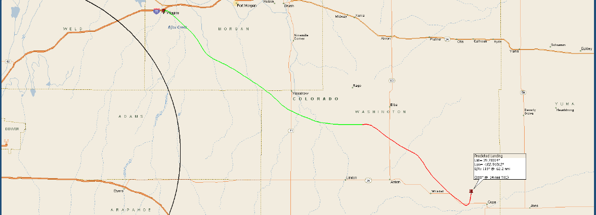
Demo Day - Planned flight path

Slide 5

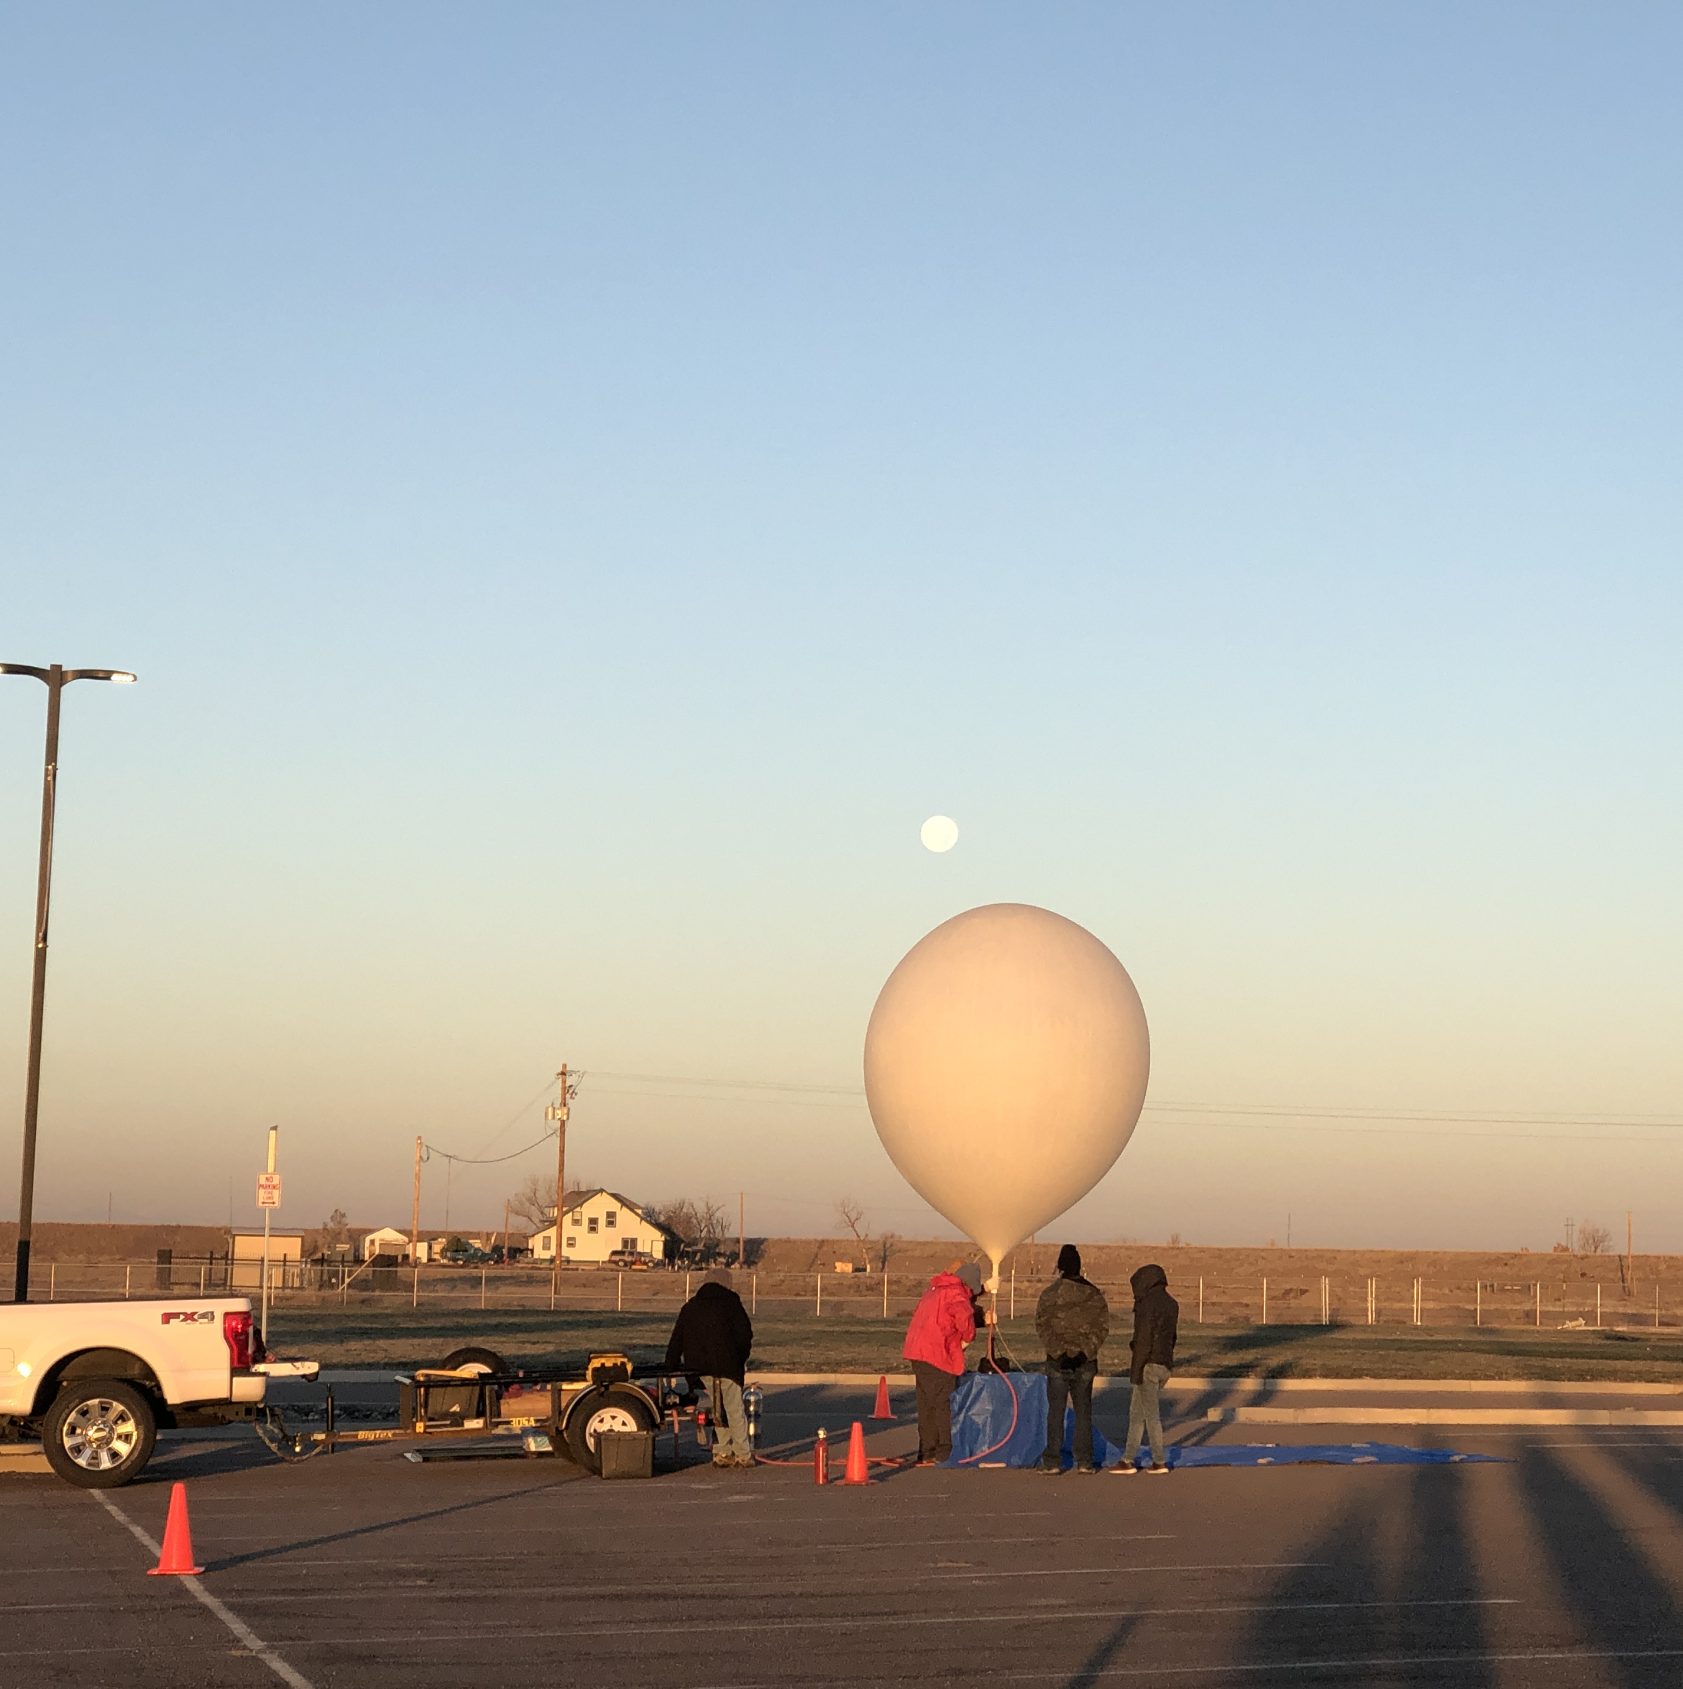
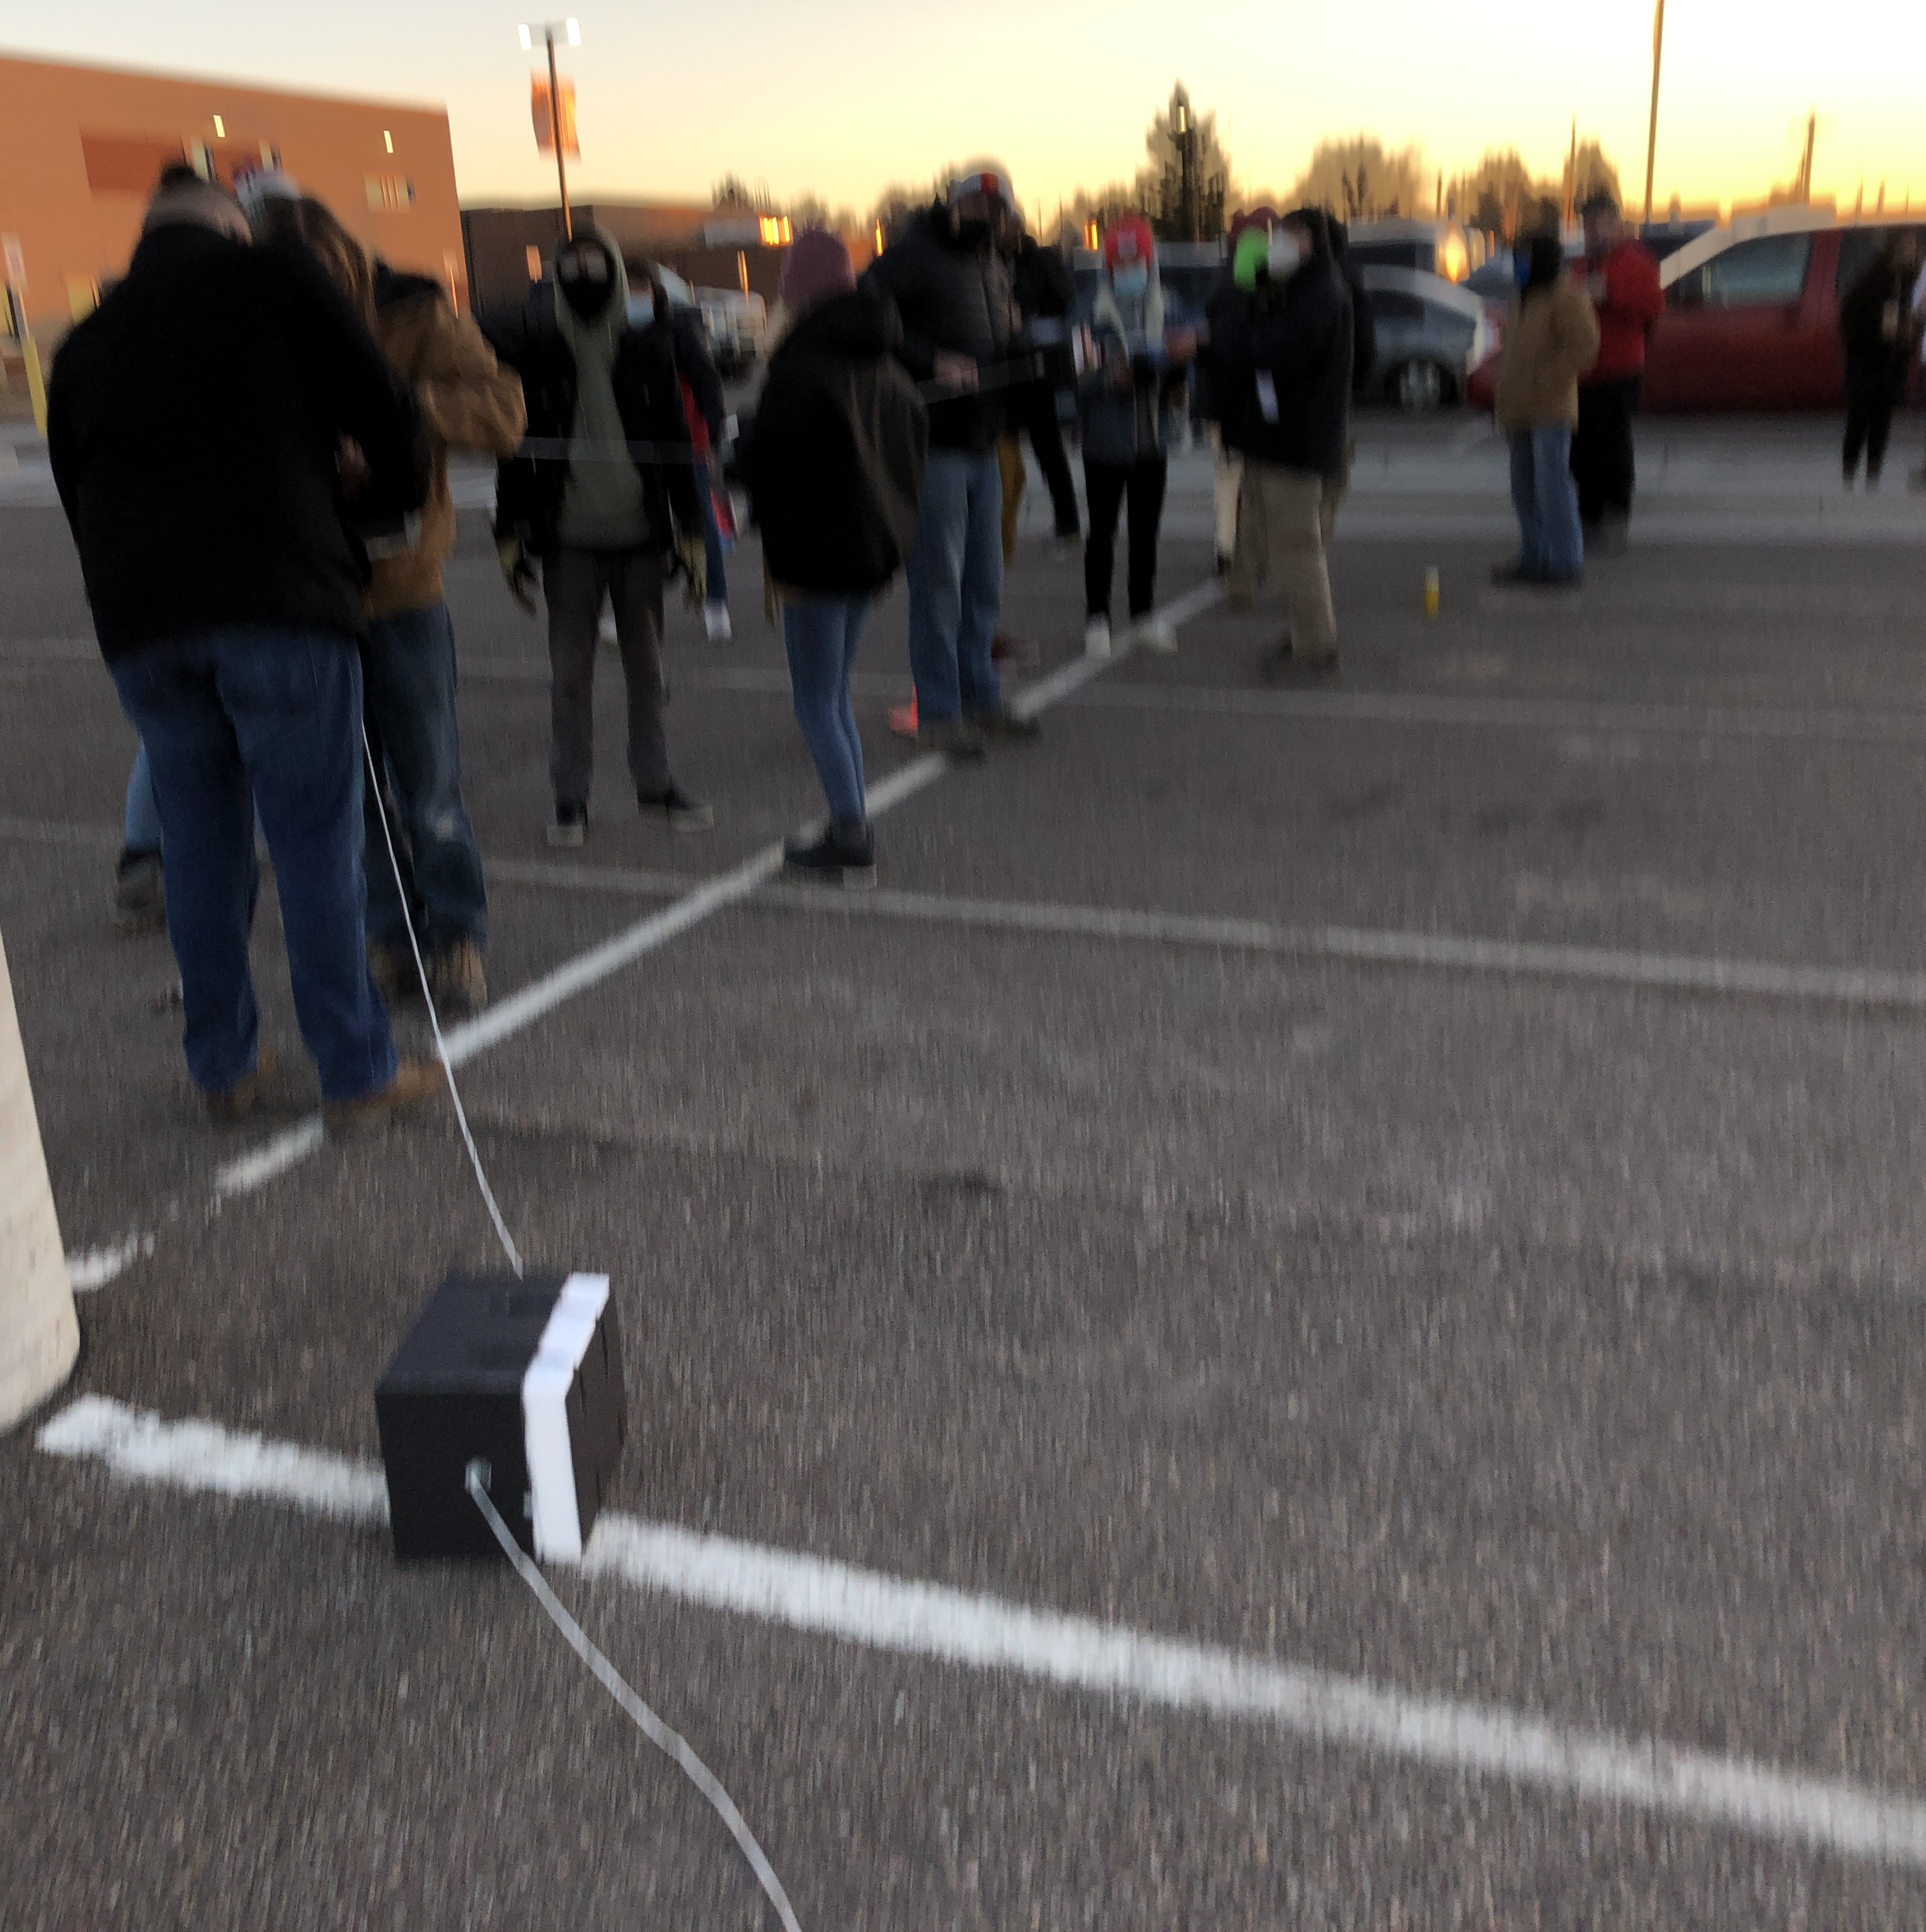
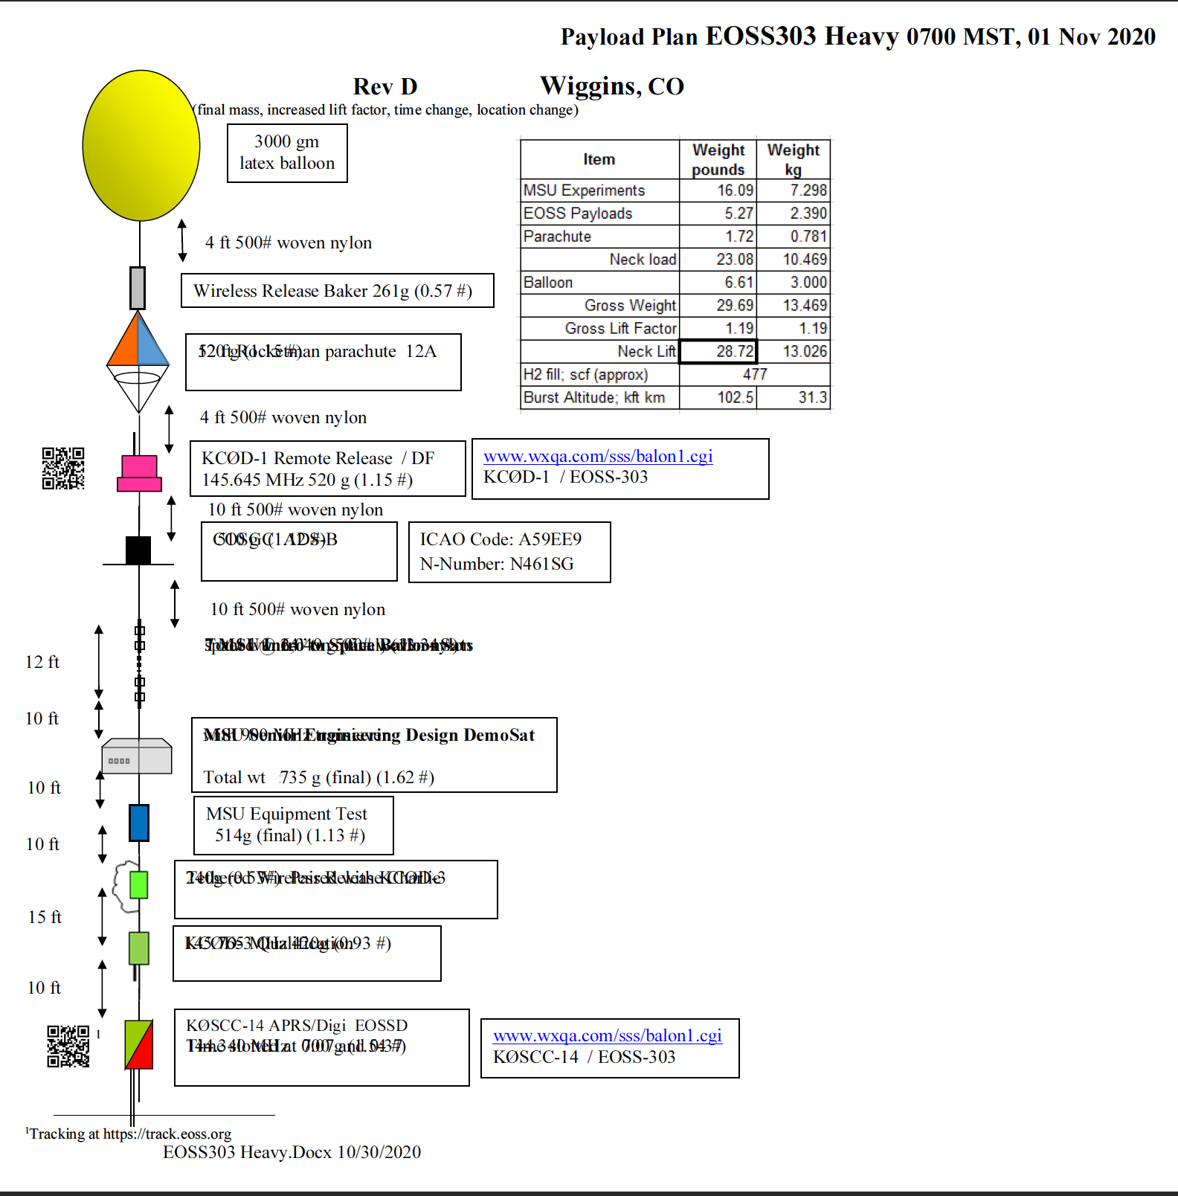
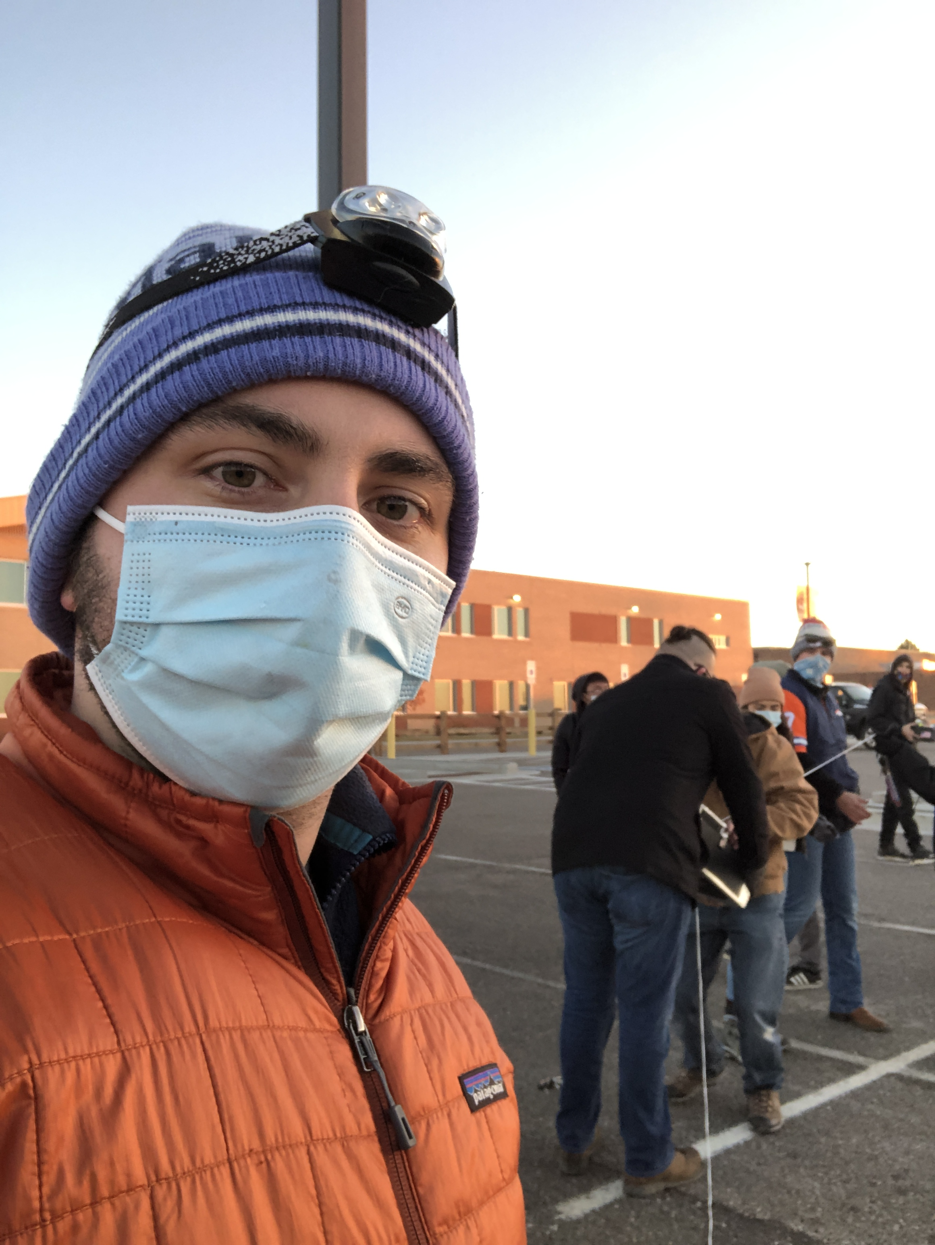
Demo day – payload and upload

Slide 6
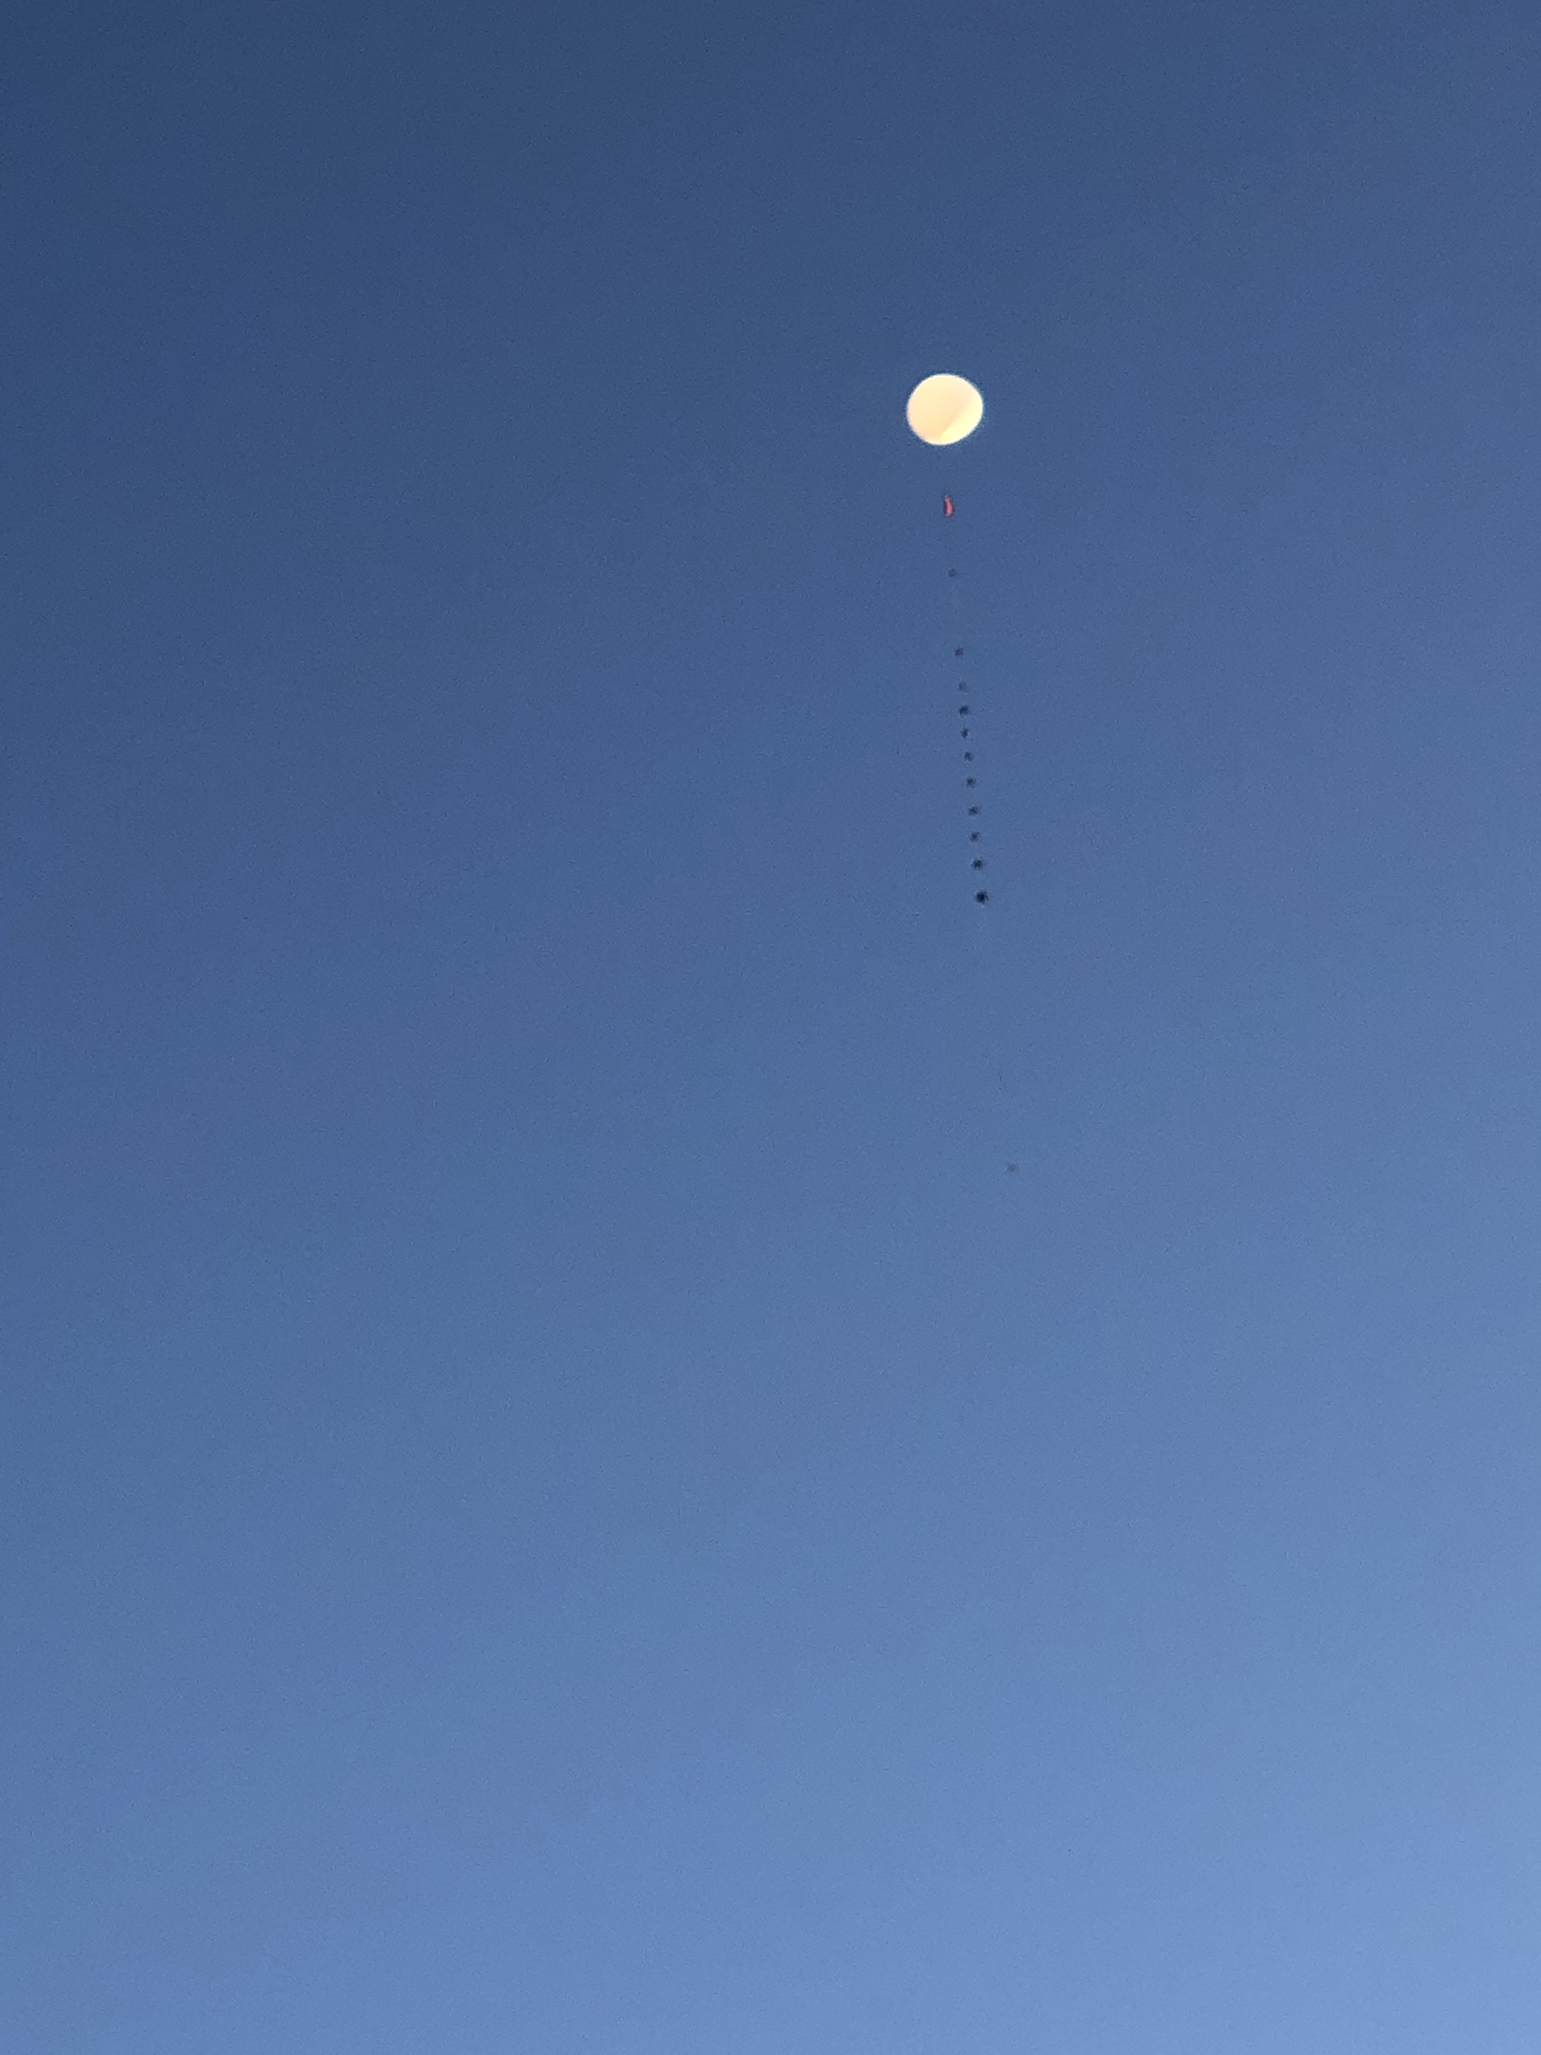
Demo Day – Go For Launch
Payload traveled over 110 miles east and gained an elevation of approximately 100,000 ft
With time traveled, troubleshooting, and communication, the team spent over 11 hours during the launch day for the testing of the system

Slide 7
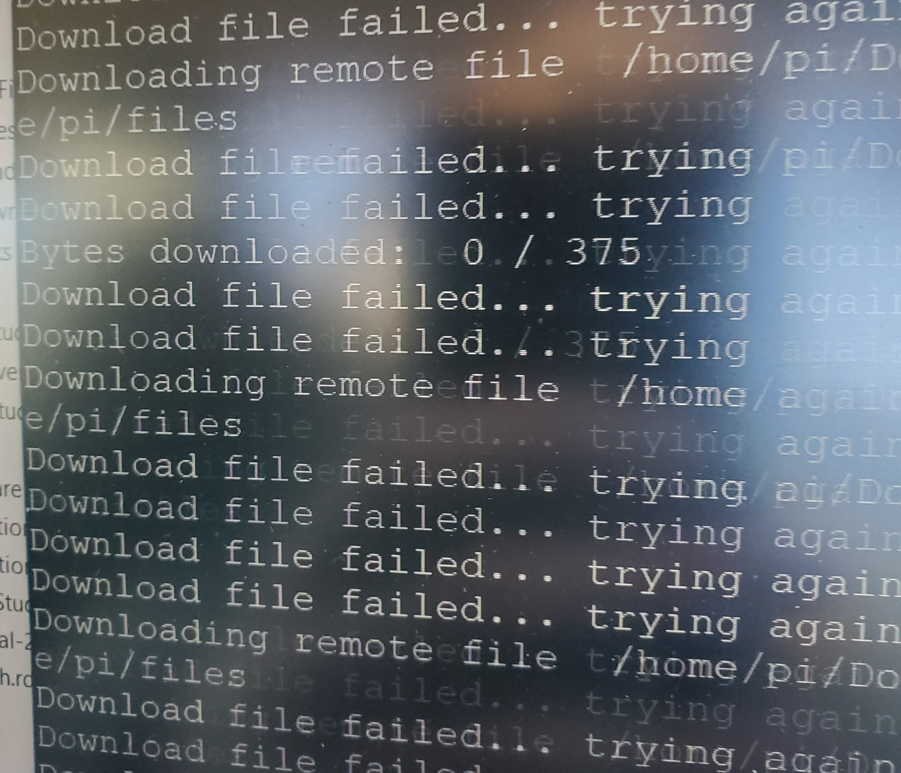
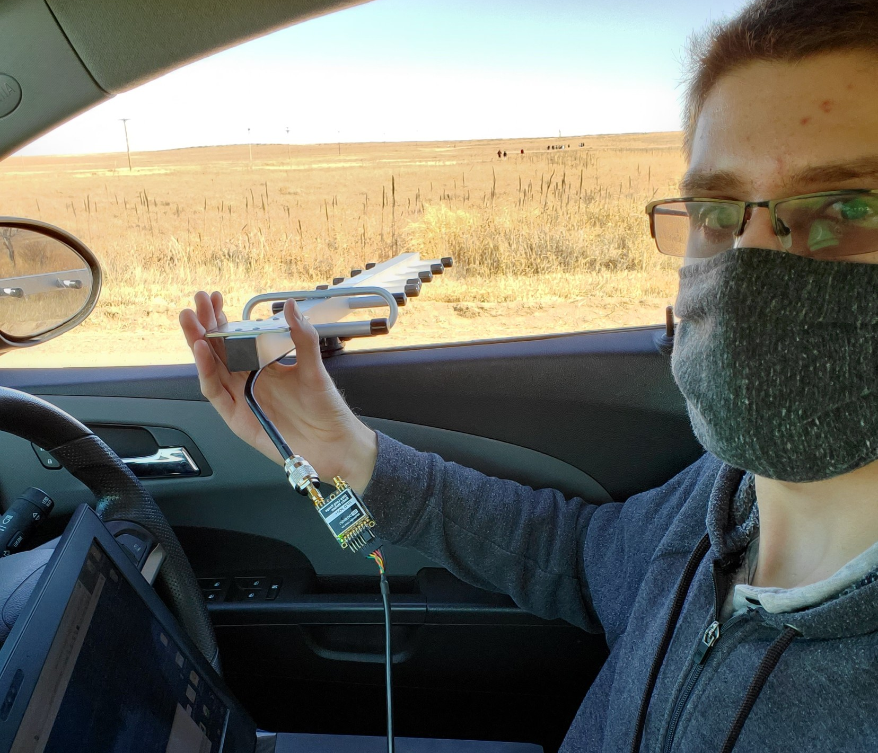
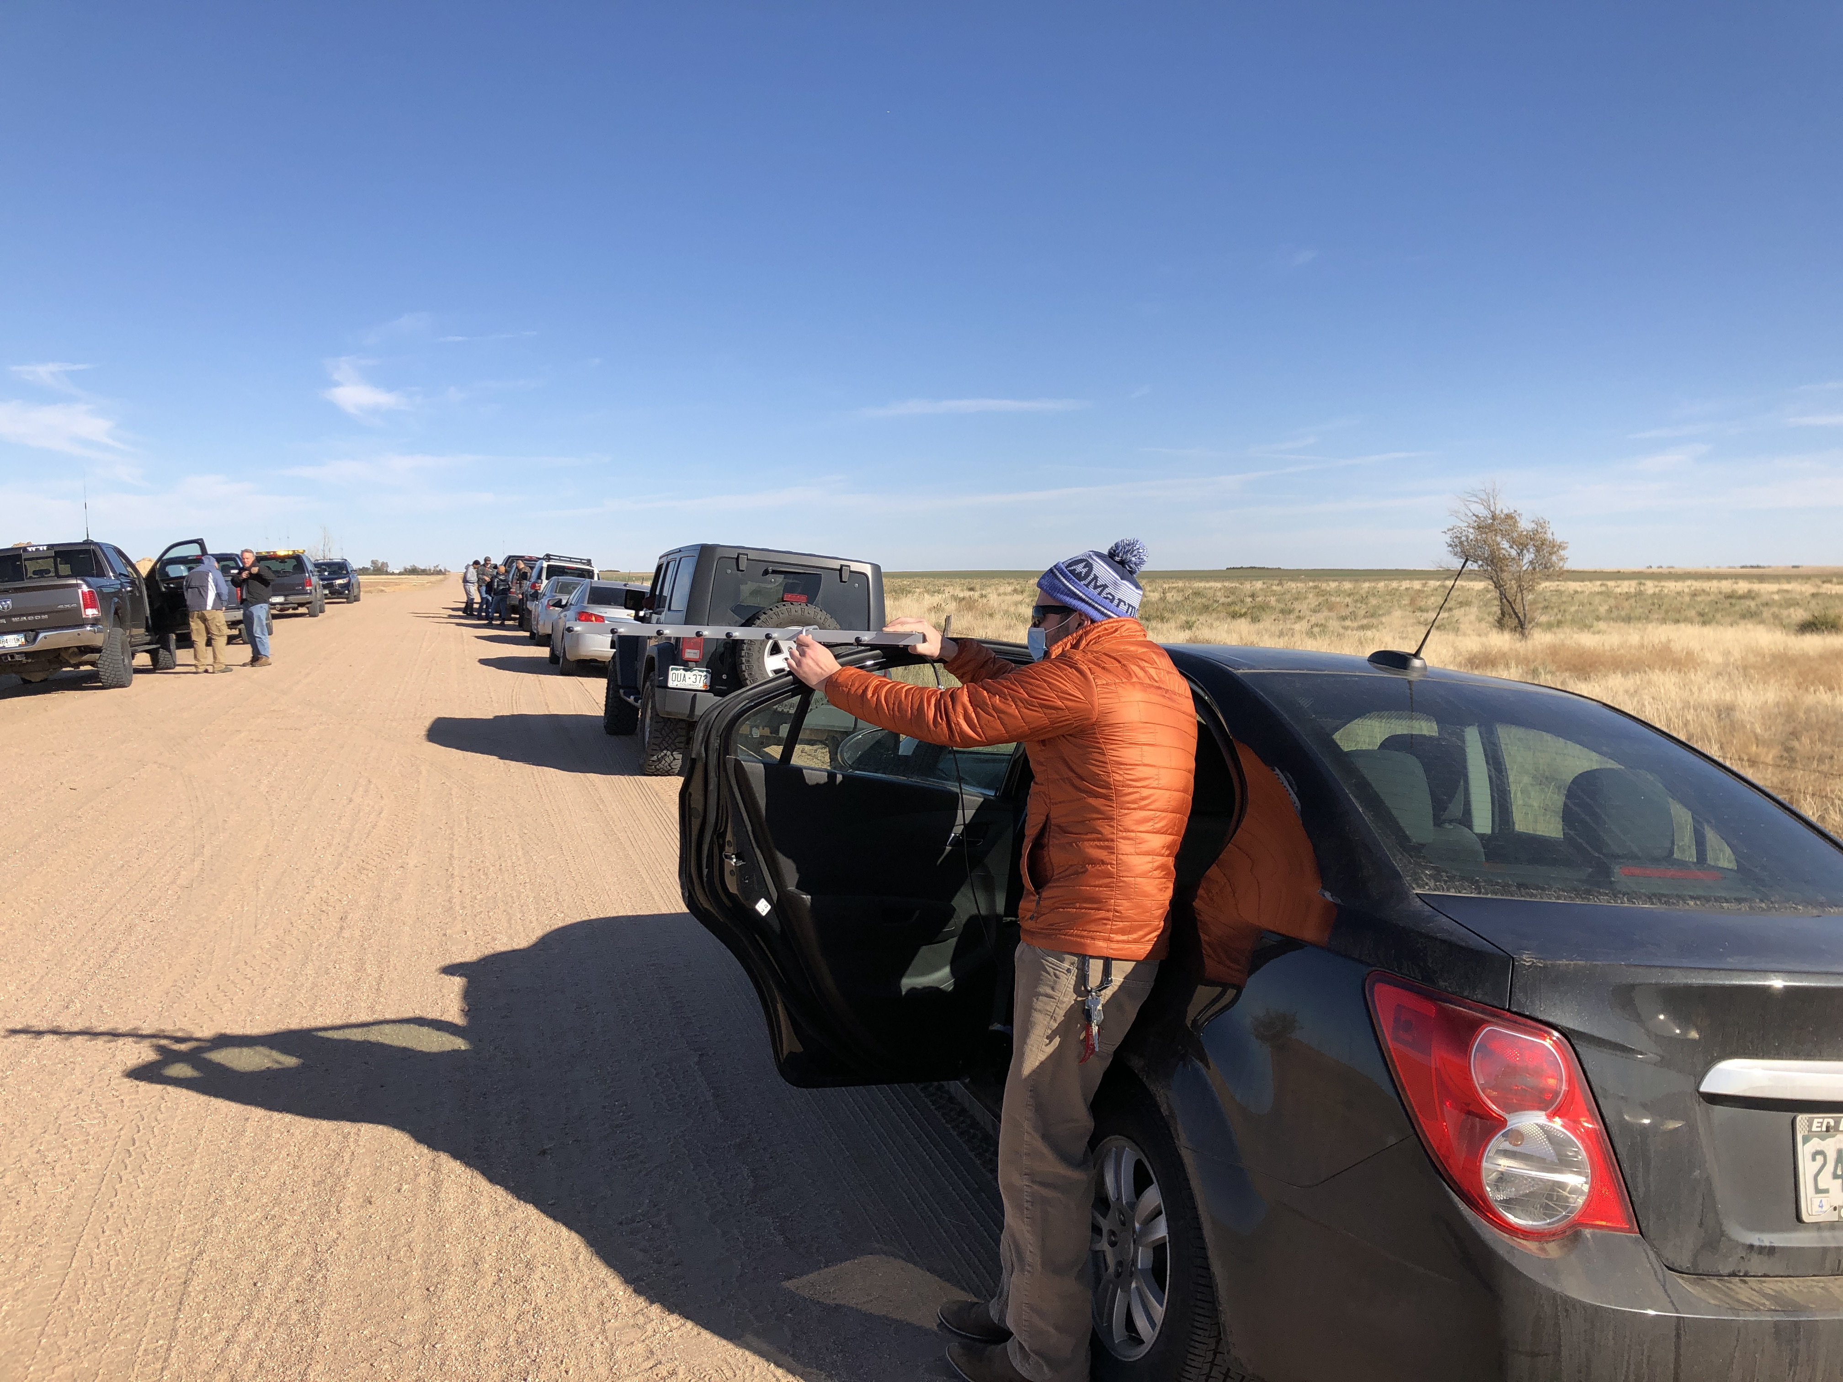
Demo Day – Searching for signal
Justin headed the ground crew using an azimuth calculator to direct the antenna towards the payload in the hopes of downloading the relevant information from the balloon satellite
Was only able to get one ping of a signal, not able to download any of the relevant information
Could be due to the link budget (not accounting for sensitivity of the antenna, available power, directional positioning of the antenna)
When the system landed the team was able to get a signal and download some of the relevant data according to the logger protocol developed by Justin and Lucas

Slide 8
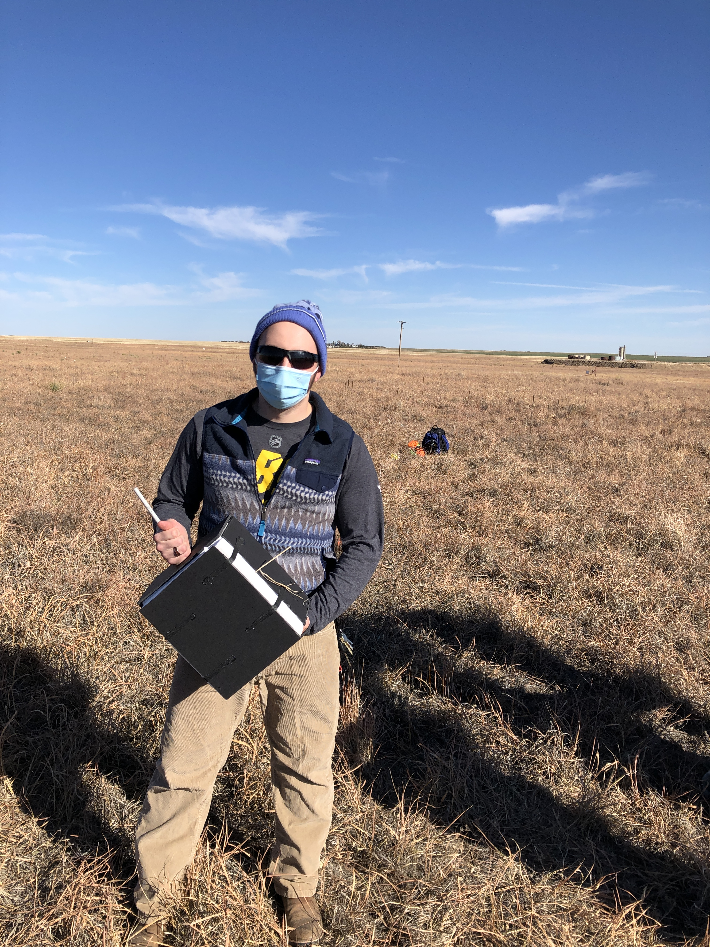
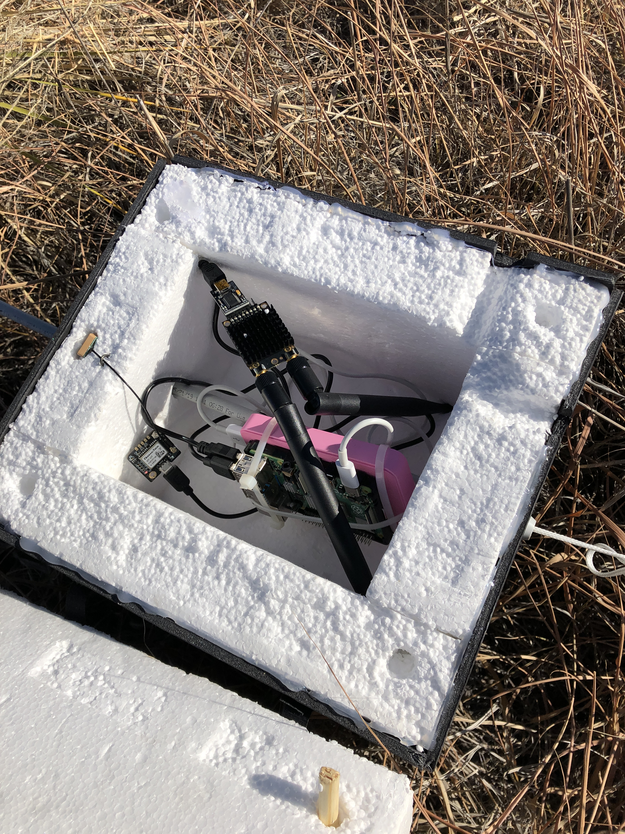
Demo Day – Payload recovery
The payload was successfully recovered with no internal damage due to excess heat or freezing
The team experienced no issues with pressure differential due to venting
All components worked normally after launch and the team was able to recover the data that was not transmitted with the logger tool, providing crucial information for the internal components when exposed to the elements

Slide 9
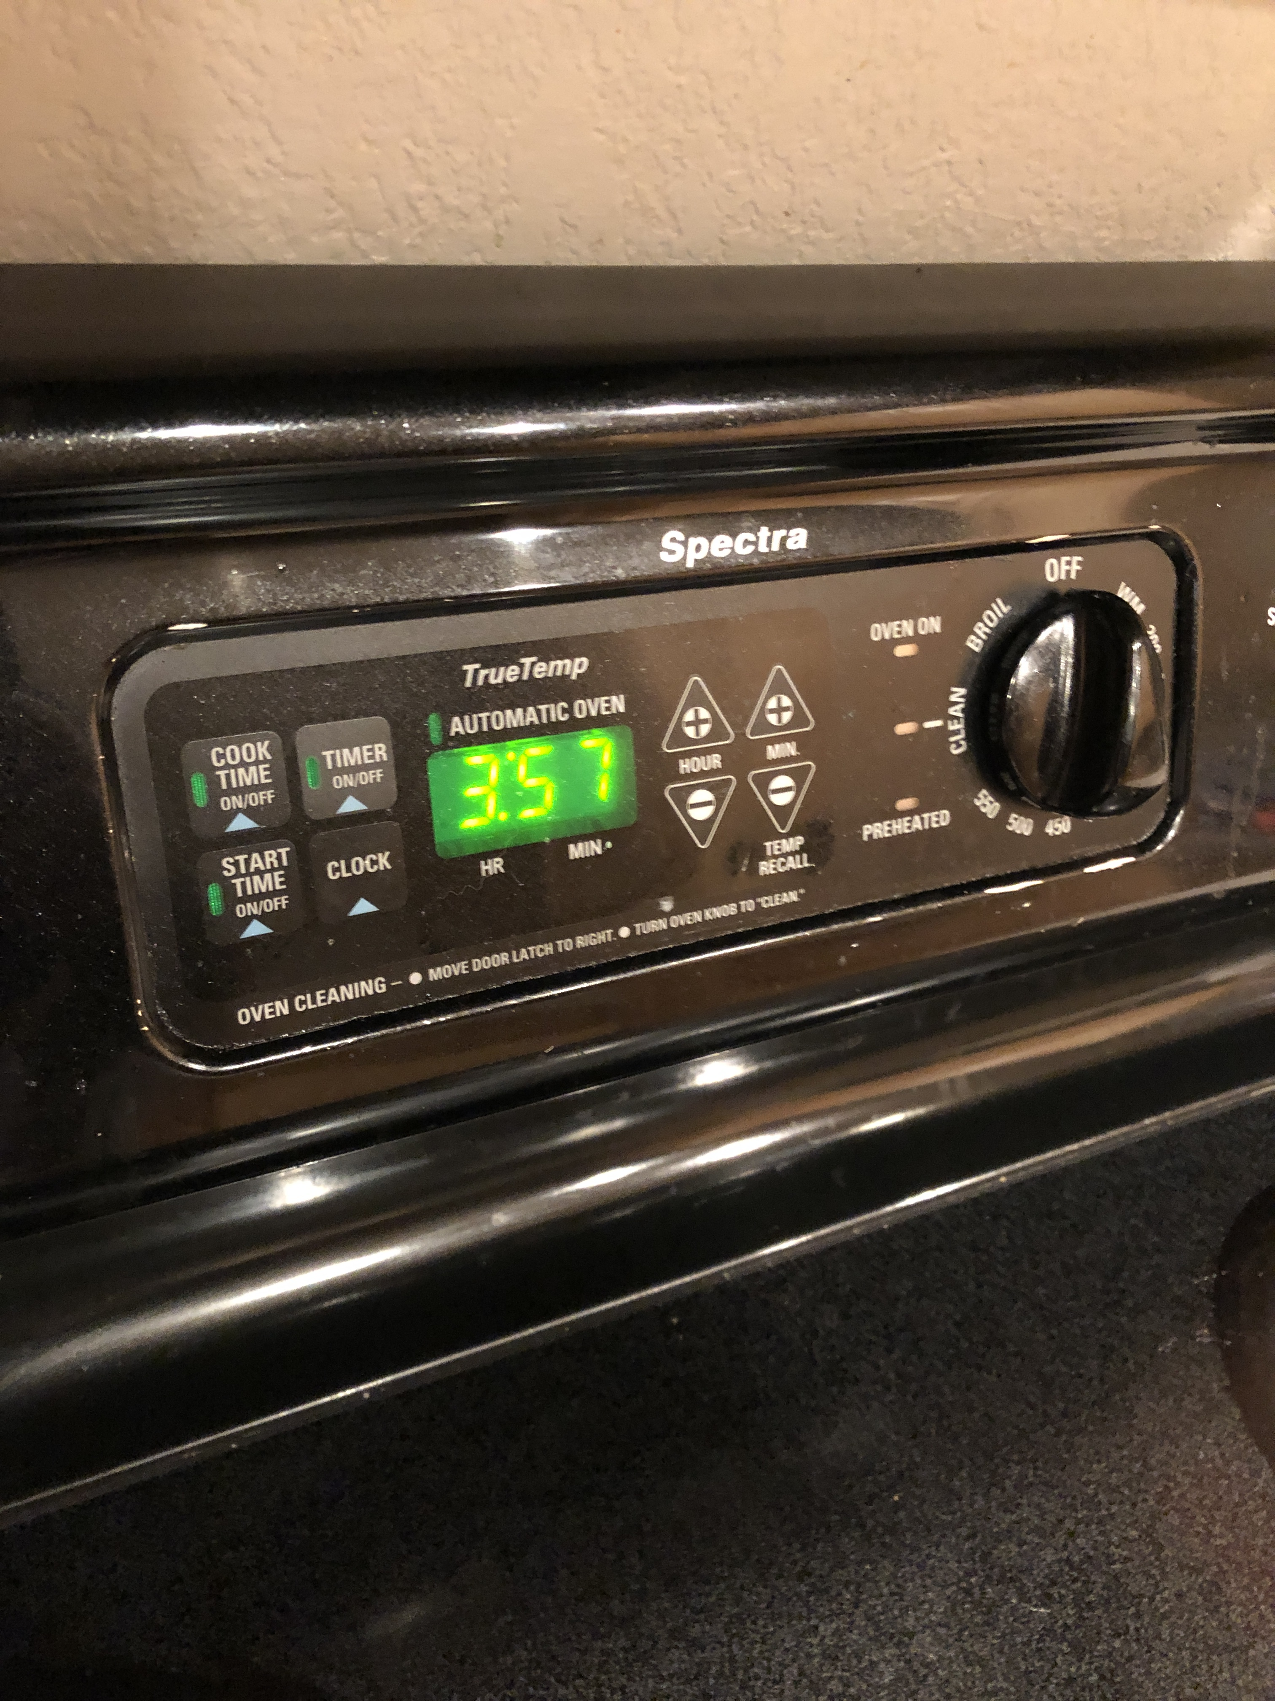

Demo Day – Launch Day Thoughts
Better communication between members regarding expectations, deliverables, and goals
Allocation of taskings and resources should better match the team members and reflect their assigned roles
Reanalyze link budget with better antenna and power tools internal to the raspberry pi
Space is hard

Slide 10
What’s Next
Reanalyze link budget
Power management integration into the raspberry pi
The construction of the aluminum chassis
Potential integration of solar panels (will require the integration of the power management tool)

